Slide 1
Efficient Diffusion Models for Image Super-Resolution
Leonardo Mariut - 1986191
Mohamed Zakaria Benjelloun Tuimy - 2190452
Neural Networks
Sapienza University of Rome

Slide 2
Table of contents
The problem & Introduction
Motivation and Aim
Method Overview
Implementation and Experiments
Results
Conclusions, Limitations & Future Work

Slide 3
Motivation and Aim
Why Super-Resolution Matters
SR is widely used in old photo restoration, medical imaging, and satellite image enhancement.
These tasks need high detail recovery while keeping realistic structure and textures.
Problem with Diffusion-Based SR
Standard diffusion models are high quality but very slow, requiring hundreds of sampling steps.
This makes them impractical for real-world or time-sensitive applications.
Our Aim:
Implement and extend ResShift, a diffusion model that works on the residual between LR and HR.
Achieve 4× SR in ~15 steps, balancing speed and fidelity.
Improve ResShift quality while maintaining similar inference time and performance.
Efficient Diffusion Models for Image Super-Resolution

Slide 4
Method Overview
ResShift (Baseline Idea)
Builds a new diffusion Markov chain that bridges
LR → HR through the residual.
Starts from an upsampled LR image (not random noise).
A custom noise schedule gradually shifts the residual to the target HR.
Why It’s Efficient
Since the LR image already contains most of the structure, the model only needs to add missing details (edges and textures).
This creates a shorter path to the solution → fewer steps, faster inference, no major quality loss.
Architecture
Dual-domain UNet, base channels 64, total params ≈1.39M.
Spatial branch, DCT branch, wavelet branch → fused features to emphasize high-frequency detail.
Skip connections across the encoder/decoder stages to preserve low-frequency structure and enable sharper reconstruction.
L1 for fidelity and VGG perceptual loss for textures.
Efficient Diffusion Models for Image Super-Resolution

Slide 5
Implementation and Experiments
Dataset Setup
DIV2K: 800 train / 200 val HR images.
Training uses random 256×256 HR crops → LR by ×4 bicubic downsample, then upsample to 256×256 for 𝑦0 ​ .
Normalization [0,1] → [-1,1].
Evaluation protocol
Metrics: PSNR, SSIM on DIV2K validation
Baseline: bicubic upsampling.
Training Setup
Predict residual with LR conditioning; η(t) schedule tuned for ~20 steps.
Example hyperparams: NUM_EPOCHS = 380, Batch = 8, LR = 1e-4, freq-loss weight ≈ 2.0.
Checkpoints saved every 10 epochs
Evaluation performed every 10 epochs.
Hardware: Nvidia GeForce RTX 5060 Ti 16Gb
Efficient Diffusion Models for Image Super-Resolution

Slide 6
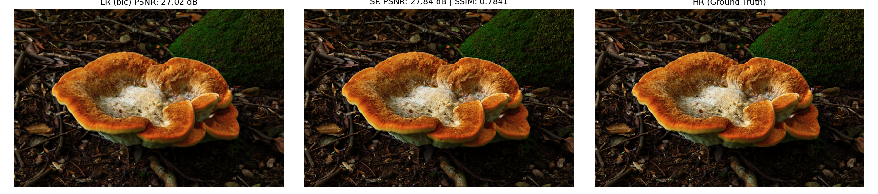
Results
Quantitative Results
ResShift (15 steps): ~29.5 dB PSNR, 0.85 SSIM.
Bicubic Baseline: ~28.14PSNR, 0.75 SSIM.
Confirmed clear fidelity gain from residual diffusion.
Inference Speed
15 steps gave a decent quality. Much faster than standard diffusion (100+ steps).
Quality plateaus around 15–20 steps → extra steps add minimal improvement.
Efficient Diffusion Models for Image Super-Resolution

Slide 7
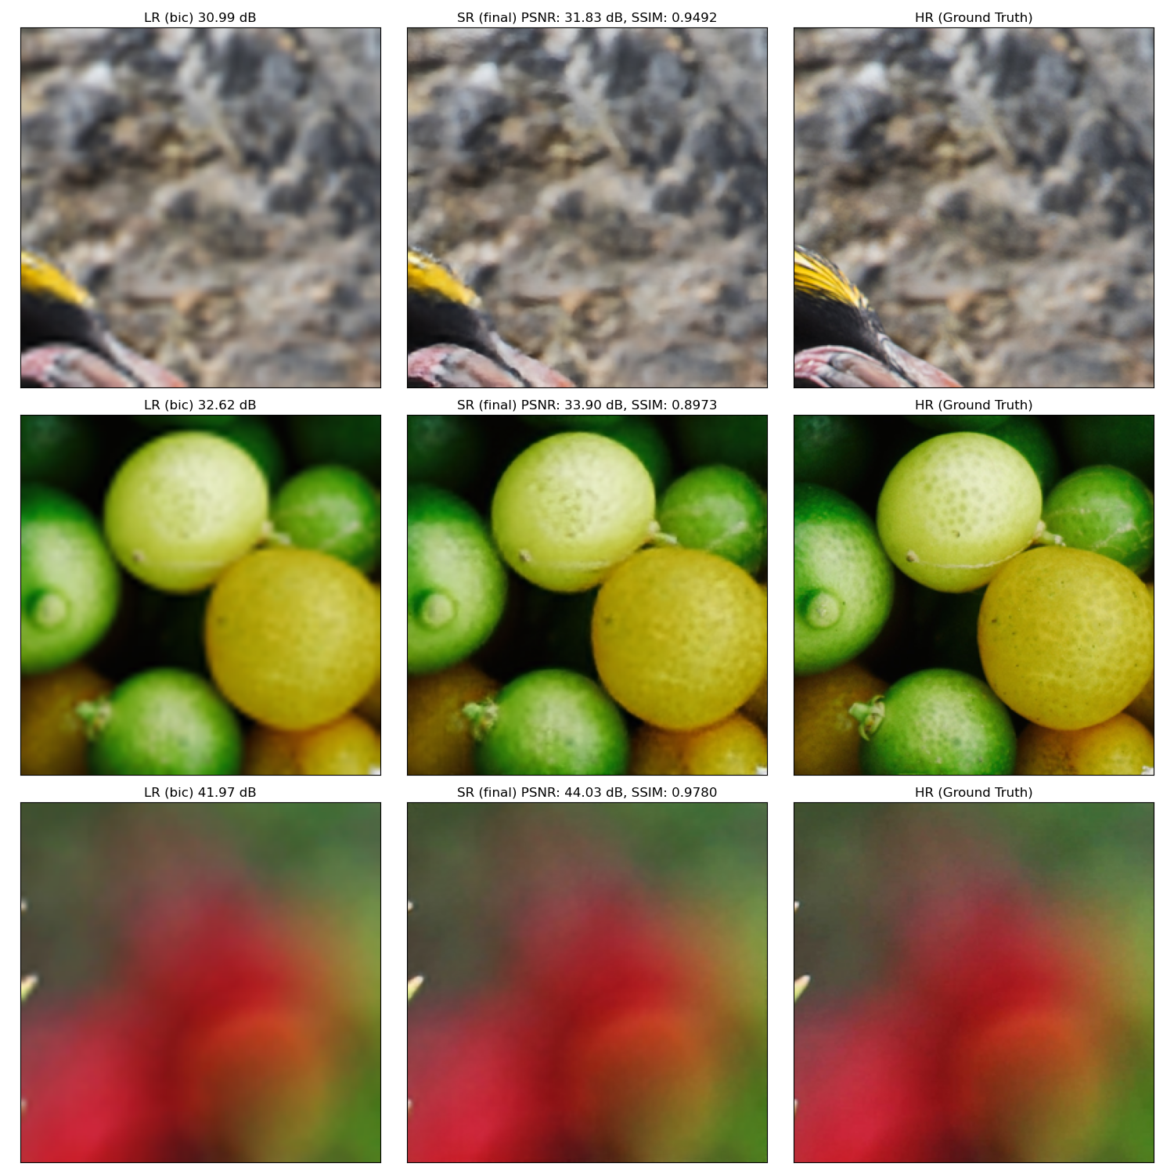
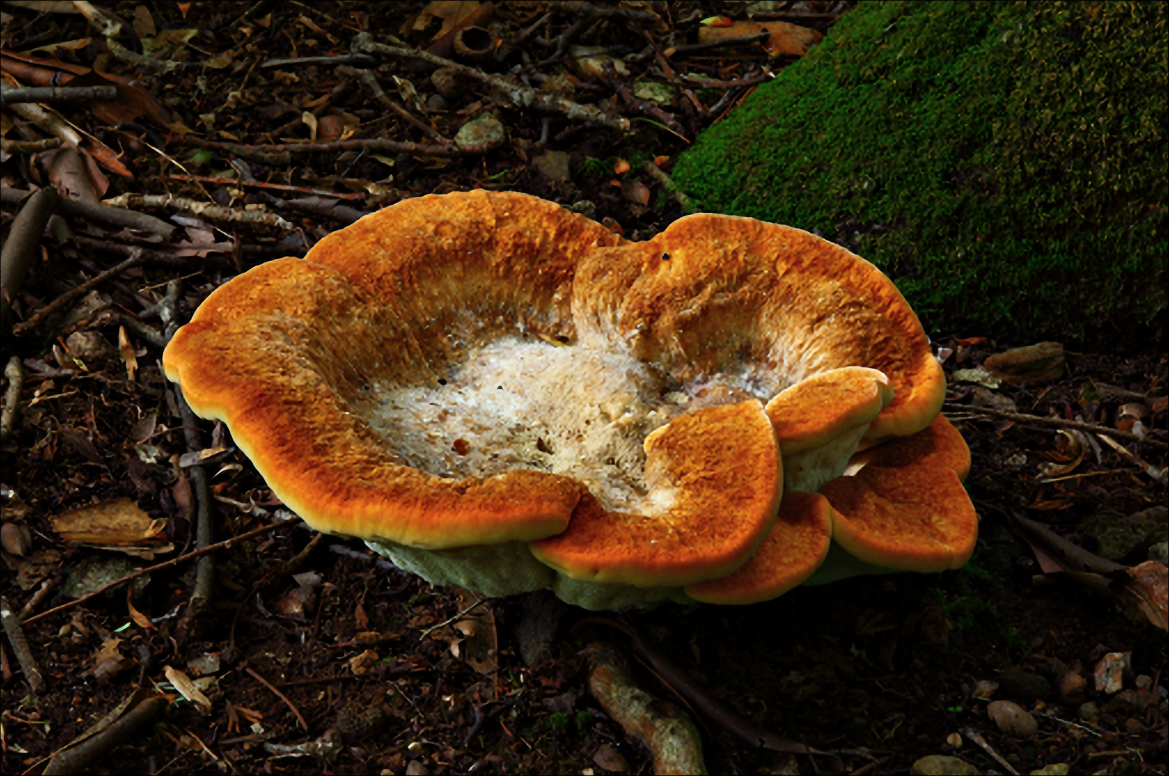
Results-2: Epoch 380 eval && SR image
Efficient Diffusion Models for Image Super-Resolution

Slide 8

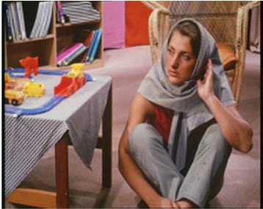
Conclusions
Goal Achieved && Key Takeaways:
Implemented ResShift and reproduced main claim: high-quality SR in ~15steps.
Efficiency: Operating on residual = fewer steps, faster inference.
Quality: Better textures and sharper details vs bicubic.
Extensions: Frequency and wavelet domain improved fine detail; continuous scaling adds flexibility.
Bicubic:
PSNR = 25.26 dB SSIM = 0.7043
SR:
PSNR = 25.04 dB SSIM = 0.7208
Efficient Diffusion Models for Image Super-Resolution

Slide 9
Limitations & Future Work
Model Limitations
Still slower than one-shot SR methods (CNNs/Transformers) since diffusion always requires multiple steps.
Training requires careful noise schedule tuning, which makes it complex to reproduce.
Dataset Limitations
DIV2K dataset is relatively small (800 training images).
Limited diversity → the model may not generalize perfectly to all real-world scenarios (e.g., medical or satellite images).
More diverse and larger datasets would likely improve robustness and detail preservation.
Hardware Limitations
Training and inference were run on limited GPU resources.
Slower training times and smaller batch sizes restricted experimentation.
Could not explore larger models or extensive hyperparameter tuning due to compute limits.
Future Directions:
Implement a training schedule that starts with only L1 for the first N epochs, then gradually adds perceptual and frequency losses.
Test reducing frequency loss to 0.0 at early steps and linearly increasing it.
Efficient Diffusion Models for Image Super-Resolution

Slide 10
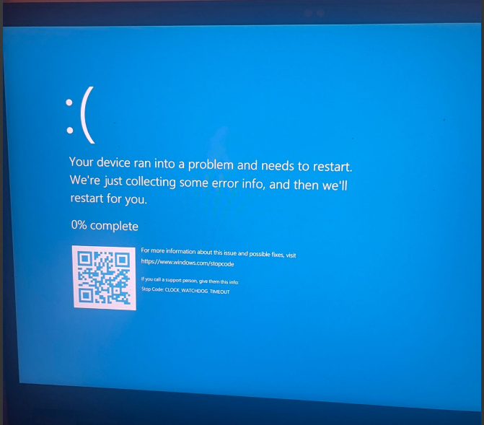
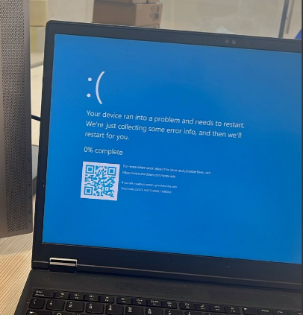

Slide 11
References
Papers:
Liu et al. (2024) – Arbitrary-Steps Image Super-Resolution with Time-Step Schedule & 2D-LUT. arXiv:2412.09013v1.
Liang et al. (2023) – Implicit Diffusion Models for Continuous Super-Resolution. arXiv:2303.16491v2.
Zhou et al. (2025) – DMNet/DDMN: Dual-domain Modulation Network for Lightweight Super-Resolution. arXiv:2503.10047v2.
Johnson et al. (2016) – Perceptual Losses for Real-Time Style Transfer and Super-Resolution. arXiv:1603.08155.
Mildenhall et al. (2020) – NeRF: Representing Scenes as Neural Radiance Fields for View Synthesis. arXiv:2003.08934.
Ronneberger et al. (2015) – U-Net: Convolutional Networks for Biomedical Image Segmentation. arXiv:1505.04597.
Slides:
https://github.com/pietro-nardelli/sapienza-ppt-template
Efficient Diffusion Models for Image Super-Resolution

Slide 12
Thank you for the attention!

